Slide 1
SMART METERING INFRASTRUCTURE
Group Members : Hema G Roll No : 30 Krishnanunni B Roll No : 36 Leo.K.A Roll No : 38 Vishnu Sreekumar Roll No : 59
Guide : Prof. Vinod.V EEE Dept Asst Professor

Slide 2
ABSTRACT
The Smart Metering Infrastructure (SMI) is an integrated system of smart meters, communication networks and data management systems that enables two way communications between utilities and customers.
SMI is a replacement for traditional analog devices with computerized smart meters which improves energy management.
By this implementation the user receives constantly the energy usage readings via their smart phones and has consumer friendly wireless load control functionality.
The project introduces an automatic meter reading mechanism which can be implemented by means of Broadband network over a secured 128 bit encrypted channel and control of loads via android application and through websites.

Slide 3
OBJECTIVE OF THE PROJECT
In our project we would like to facilitate in improved cash flow management in energy utilities and the deployment of manpower for taking meter readings, by implementing microcontrollers and wireless (Wifi) Modules.
SMI creates transparency about energy consumption and incentivise consumers to adjust their routine in order to lower their energy consumption and thus energy costs.
By this the user receives the usage, which eliminate the difficulty of approaching the meter constantly.
Our project aims to improve energy management and to provide an accurate and economical computerized metering system.

Slide 4
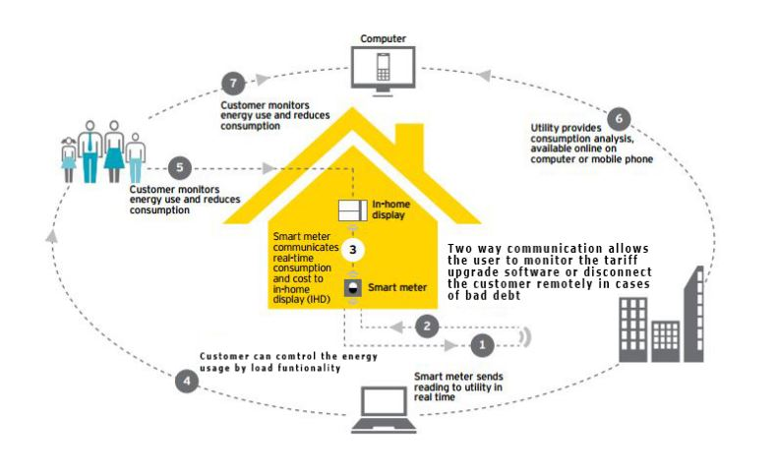
FLOW CHART

Slide 5
Introduction
There are many flaws and errors in conventional billing.
Some human mistakes may also occur in manual billing.
It’s a time consuming procedure
There is always a chance of human error while taking the manual meter reading
There is no check and balance and verification procedure of this meter reading
There is always a chance of theft and corruption
Extra human power is required
Consumer is not updated of his usage

Slide 6


Block Diagram
Load Controller (Relays)
ARDUINO (MEGA)
RF Module
Analog Front End with metering IC (STPM01)
PIC
with
LCD
Display
Raspberry Pi
Touch Switch
Reed
Server
Modem
Energy Measuring Unit
Smart Load Controlling Unit

Slide 7
Components Used
STPM01
PIC18F455
16x2 lcd
Raspberry Pi B+
Level Shifter
ULN2004A Relay
GSM Module
Arduino Mega
Relays
Modem

Slide 8
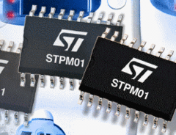
STPM01
The STPM01 is designed for effective measurement of active, reactive and apparent energy in a power line system using Rogowski coil, current transformer and shunt sensors.
The STPM01 consists, essentially, of two parts: the analog part and the digital part.
In the STPM01 an output signal with pulse frequency proportional to energy is generated, this signal is used in the calibration phase of the energy meter application allowing a very easy approach.

Slide 9
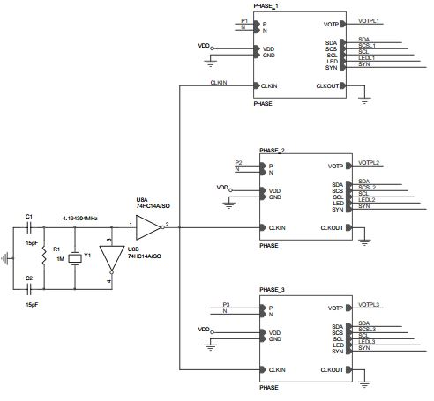
Configuration of STPM01 IC :
Different configuration
Configuration of STPM01 IC with PIC mirco-controller.
SDA to RB00
SCL to RB01
SCS to RB05
SYN to RB06
//PROGRAM

Slide 10
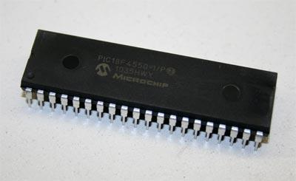
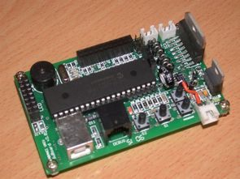
PIC18F4550
PIC18F4550 is an 8-bit microcontroller of PIC18 family. PIC18F4550 is an advanced microcontroller which is equipped with enhanced communication protocols like EUSART, SPI, I²C, USB etc.

Slide 11
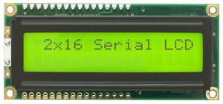
16x2 lcd wiki
LCD_RS – RD2
LCD_EN – RD3
LCD_D4 – RD4
LCD_D5 – RD5
LCD_D6 - RD6
LCD_D7 - RD7
LCD (Liquid Crystal Display) screen is an electronic display module and find a wide range of applications.
A 16x2 LCD display is very basic module and is very commonly used in various devices and circuits. These modules are preferred over seven segments and other multi segment LEDs.

Slide 12

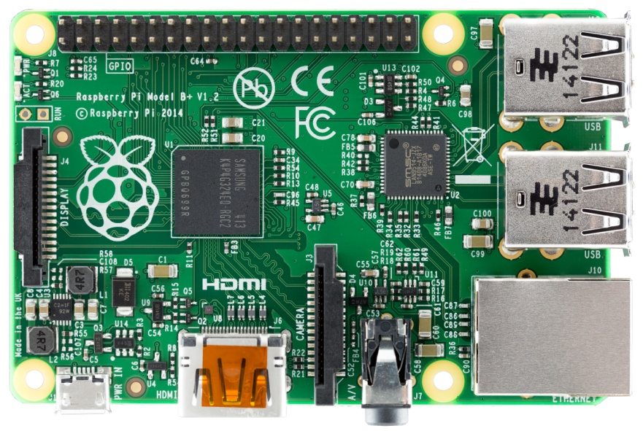
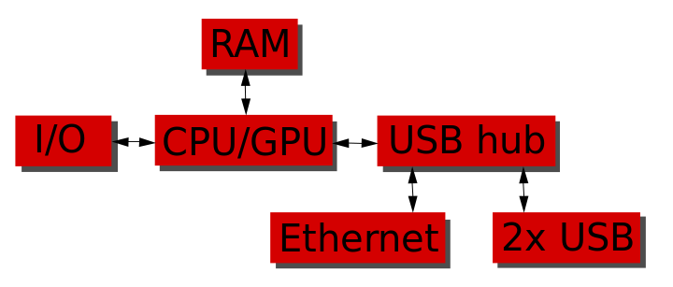
RASPBERRY PI 2
The Raspberry Pi is a series of credit card-sized single-board computers

Slide 13
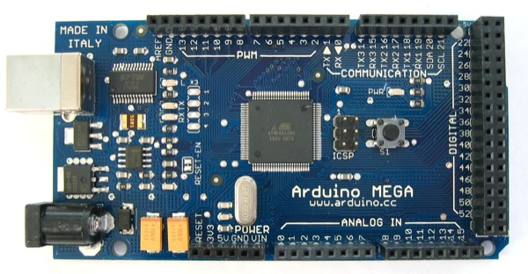
Arduino Mega
The Arduino Mega is a microcontroller board based on the ATmega1280 .It has 54 digital input/output pins (of which 14 can be used as PWM outputs), 16 analog inputs, 4 UARTs (hardware serial ports), a 16 MHz crystal oscillator, a USB connection, a power jack, an ICSP header, and a reset button. It contains everything needed to support the microcontroller; simply connect it to a computer with a USB cable or power it with a AC-to-DC adapter or battery to get started. The Mega is compatible with most shields designed for the Arduino Duemilanove or Diecimila.

Slide 14
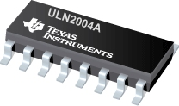
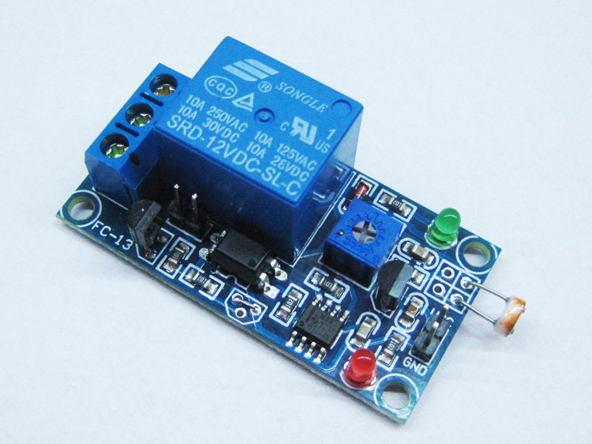
ULN2004A Relay
ULN2004Aare high voltage, high current darlington arrays each containing seven open collector darlingtonpairswith common emitters. Each channel is rated at 500mA and can withstand peak currents of 600mA.

Slide 15
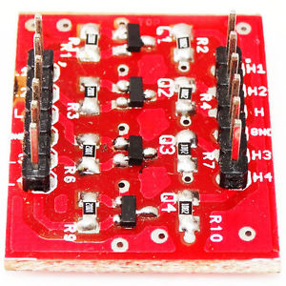
Level Shifter
Bi-directional level shifter and translator circuits are used to interface between applications with different supply voltage and input-output voltage levels.
3.3V to 5 V

Slide 16
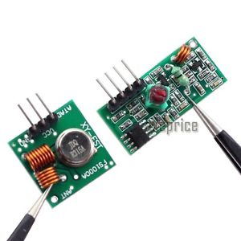
RF TRANSMITTER AND RECEIVER
This RF module comprises of an RF Transmitter and an RF Receiver. The transmitter/receiver (Tx/Rx) pair operates at a frequency of 434 MHz. An RF transmitter receives serial data and transmits it wirelessly through RF through its antenna connected at pin4. The transmission occurs at the rate of 1Kbps - 10Kbps.The transmitted data is received by an RF receiver operating at the same frequency as that of the transmitter.

Slide 17
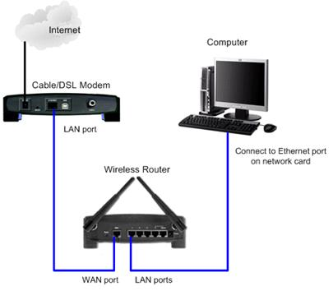
modem / router
The modem establishes and maintains the connection with the Internet
provider's service and converts the signals from and to the router appropriately.
The router forwards traffic destined for the Internet to the modem, while
keeping internal traffic (computer to computer, computer to printer, etc.) from
leaving the network.

Slide 18
Energy Measuring Unit
Consist of a power measuring IC and a Microcontroller IC.
Power measuring IC (IC STPM01) converts the input AC signal to equivalent digital values to be read by microcontroller.
Microcontroller intakes the digital value and calculates the real time power in kWh and is displayed in LCD.

Slide 19
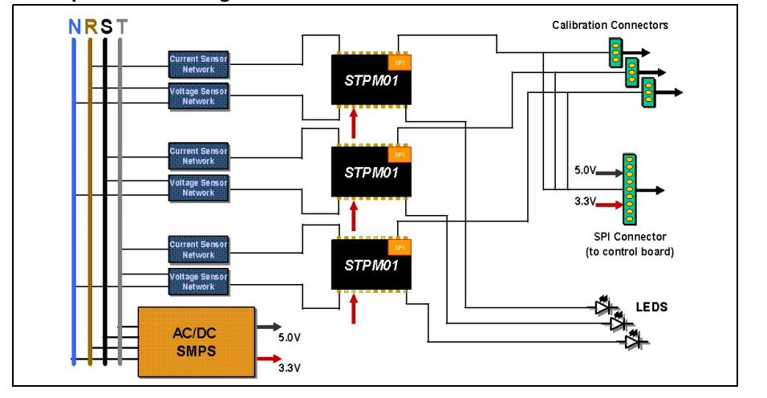
Working Principle

Slide 20
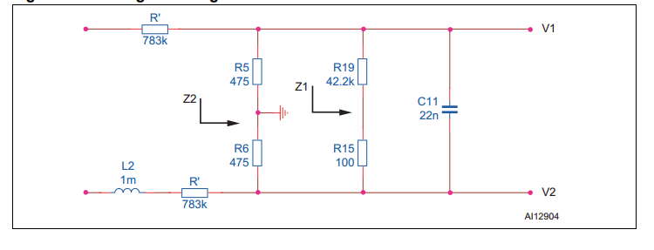
Voltage Sensing Circuit

Slide 21
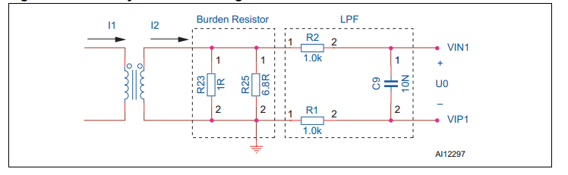
Current Sensing Circuit

Slide 22
Additional Filters
Anti-aliasing Filter
An anti-aliasing filter (AAF) is a filter used before a signal sampler to restrict the bandwidth of a signal to approximately or completely satisfy the sampling theorem over the band of interest.
Crosstalk Cancellation Network
When voltage and current are not in phase, crosstalk has a non-linear effect on the measurements, which cannot be calibrated.

Slide 23
Smart Load Controlling Unit
Load controlling unit comprises of mainly Raspberry PI microcontroller IC providing load controllability with Arduino Mega controlling via RF module coupled with relays, via Touch Switch and via Reed switch, and Broadband interfacing with Modem/Router.
Load controlling is done through smart phones.
Load monitoring and controlling is possible over broadband via a dedicated server.

Slide 24
BLOCK DIAGRAM
ARDUINO (MEGA)
Load Controller
RF Module
Raspberry Pi
Load Controller
Touch Switch
Reed
Load Controller
Modem
Server

Slide 25
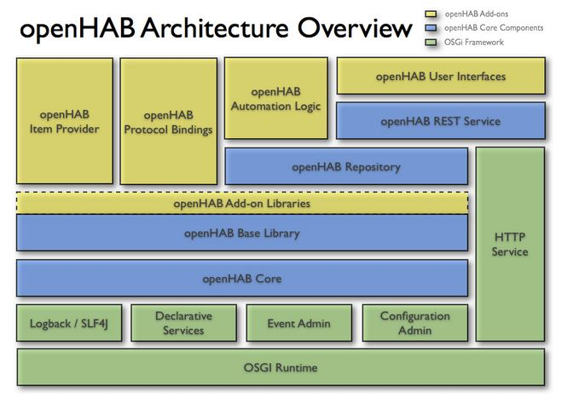

Slide 26
OPENHAB
5 Different Configuration Openhab Designer
Rules
Items
Persistence
Sitemap
Transform
//Program

Slide 27
Freeboard.io and Dweet.io
The Freeboard displays the values as various widgets available from the server cloud Dweet to which the sensed values are transferred via the Raspberry Pi.
//Program

Slide 28
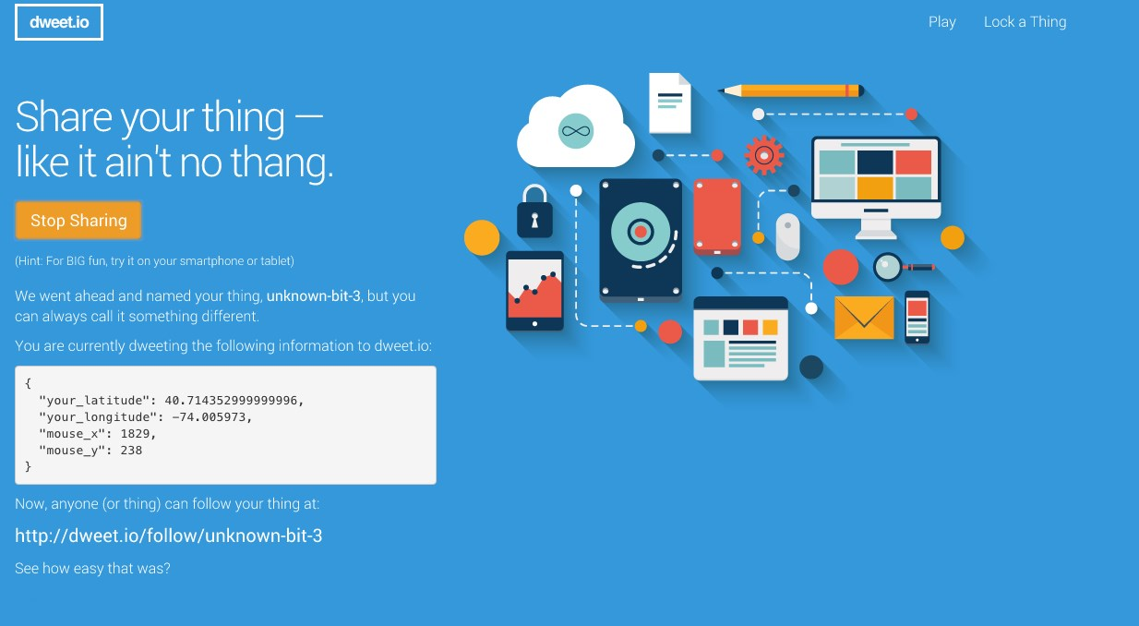

Slide 29
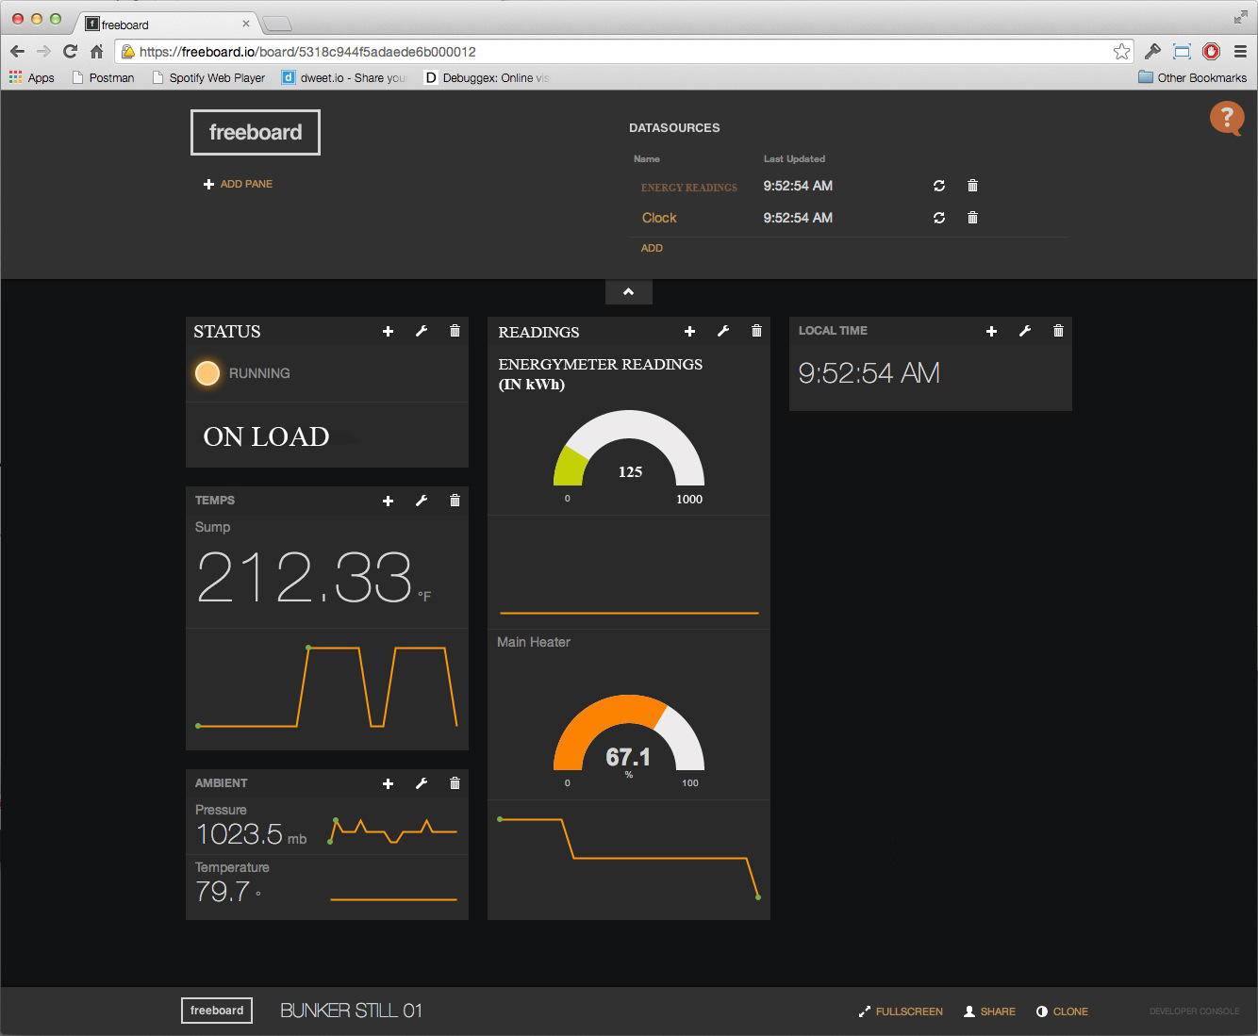

Slide 30
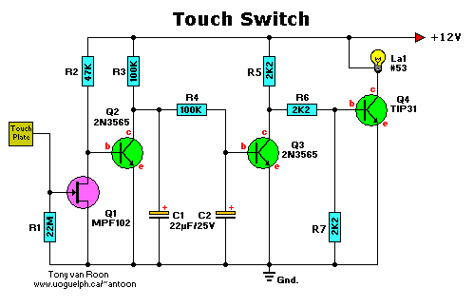
Touch Switch
A touch switch is a switch that is turned on and off by touching a wire contact, instead of flicking a lever like a regular switch. Touch switches have no mechanical parts to wear out, so they last a lot longer than regular switches.

Slide 31
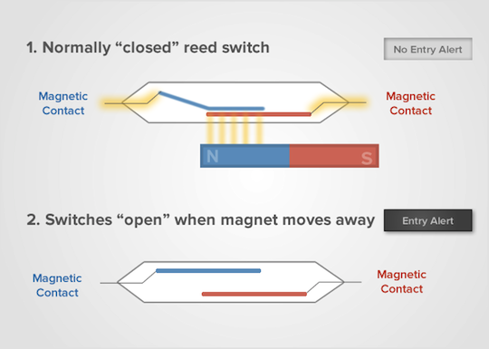
Reed Switch
The reed switch is an electrical switch operated by an applied magnetic field.

Slide 32
SOFTWARES AND LANGUAGES USED
Mikro C
ISIS Software
Arduino C
Pyhton
PLATFORM USED
Linux
PIC
Andrino

Slide 33
RESULT
SMI measures the energy (in kWh) using the STPM01 IC and displays in the LED display through the PIC MCU efficiently.
The Raspberry Pi acts as a control station for interfaces for various systems for monitoring and controlling purposes.
The energy values and the other sensed values like the temperature are displayed in various websites using the open-source servers like openhab and displays in website widgets using dweet.io and freeboard.io.
The values are displayed in the smart phones through android application installed in it using the open-source applications of arduino openhab.
The loads are controlled manually using a touch switch with a feedback which enhances the energy management effectively.

Slide 34
Future Scope
Electricity usage can be monitored directly by K.S.E.B using broadband functionality and the connections can be made tamper proof by additional sensors installations.
Consumer friendly load functionality can be enhanced via smart phone interfacing by introducing individual room controls and complete Home Automation which further improves the energy usage efficiency and helps in energy conservation.
Better load forecasting and management can be done in the advancements of SMI for both customers as well as suppliers.
Energy Suppliers will be able to improve the accuracy of forecasting their maximum load demand at different seasons and at various times of day and will be able to purchase energy contracts more efficiently.

Slide 35
Conclusion
In the present situation energy consumption is monitored manually. To reduce the manual efforts, improving accuracy and for increasing the load controllability, we need to have some kind of automated system monitoring all the parameters and functioning of the connections between the customer and electricity board.
In this system to save time of consumer, the energy consumption and corresponding price is displayed in their phones and also websites for the consumer benefits. By the implementation of this system the overall efficiency of operation of the electric board will improve
An attempt is made in this work to develop a system, where in complexity of the circuit is reduced and meter cost also get reduced.
The consumers and the suppliers can be benefited by using the Smart Metering Infrastructure (SMI).

Slide 36
REFERENCE
http://www.microchip.com
Design and Development of PIC Microcontroller Based 3 Phase Energy Meter Thousif ahamed1, A.Sreedevi2 Department Electrical and Electronics Engineering, R.V. College Of Engineering, Bangalore, Indias1,2 (International Journal of Innovative Research in Science, Engineering and Technology)
https://github.com
http://www.instructables.com
http://www.edaboard.com

Slide 37
THANK YOU

